Slide 1
Course Title: Engineering Chemistry-1
Course Code: CHE109
(Chapter 5)
Dr. Joyanta Kumar Saha
Associate Professor
Department of Chemistry
Jagannath University

Slide 2
Oxidation and Reduction
Oxidation: Oxidation may be defined as loss of electrons from a substance, the other definition of oxidation reactions states that the addition of oxygen or the more electronegative element or removal of hydrogen or the more electropositive element from a substance is called an oxidation reaction.
2S(s) + O₂ (g) → SO₂ (g) CH₄ (g) + 2O₂ (g) → CO₂ (g) + 2H₂O (l)
Reduction: Reduction reactions are defined as the gain of electrons. In other forms, the reduction reaction is stated as the addition of hydrogen or more electropositive element or removal of a more electronegative element or oxygen from a substance.
CH₂CH₂ (g) + H₂ (g) → CH₃CH₃ (g)

Slide 3
Oxidation States: The concept of oxidation states (also called oxidation numbers) provides a way to keep track of electrons in oxidation–reduction reactions, particularly redox reactions involving covalent substances. For a covalent bond between two identical atoms, the electrons are split equally between the two. In cases where two different atoms are involved (and the electrons are thus shared unequally), the shared electrons are assigned completely to the atom that has the stronger attraction for electrons. In H₂O, oxygen has a greater attraction for electrons than does hydrogen. Therefore, in assigning the oxidation state of oxygen and hydrogen in H2O, we assume that the oxygen atom actually possesses all the electrons. Recall that a hydrogen atom has one electron. Thus, in water, oxygen has formally “taken” the electrons from two hydrogen atoms. This gives the oxygen an excess of two electrons (its oxidation state is -2) and leaves each hydrogen with no electrons (the oxidation state of each hydrogen is thus +1).

Slide 4
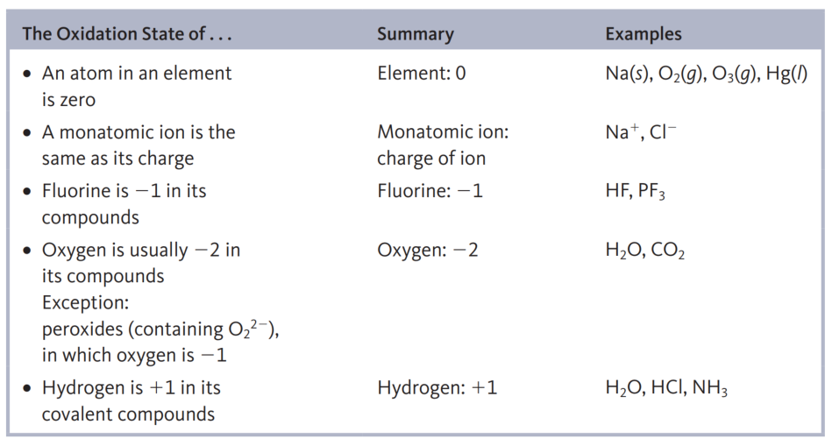
The oxidation states (or oxidation numbers) of the atoms in a covalent compound as the imaginary charges the atoms would have if the shared electrons were divided equally between identical atoms bonded to each other or, for different atoms, were all assigned to the atom in each bond that has the greater attraction for electrons. Of course, for ionic compounds containing monatomic ions, the oxidation states of the ions are equal to the ion charges.
Rules for Assigning Oxidation States:

Slide 5
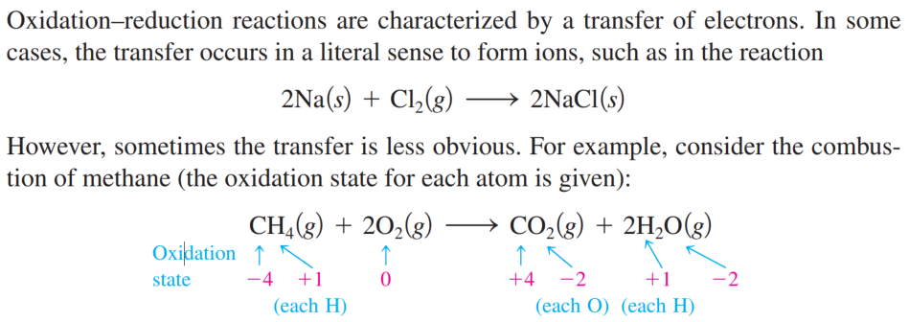
Assign oxidation states to all atoms in the following
a. CO₂ b. SF₆ c. NO₃⁻
Fe₃O₄, Fe = +8/3. Actually two Fe is +3 and one Fe +2
C=+4
S=+6
N=+5
x+(-2x3)=-1 => x=+5
The Characteristics of Oxidation–Reduction Reactions:

Slide 6
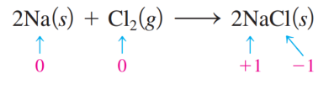
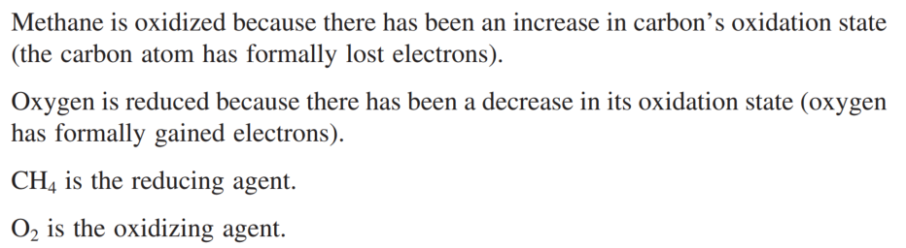
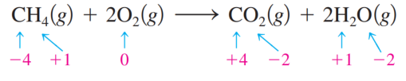
Oxidation is an increase in oxidation state (a loss of electrons). Reduction is a decrease in oxidation state (a gain of electrons). Thus in the reaction sodium is oxidized and chlorine is reduced. In addition, Cl2 is called the oxidizing agent (electron acceptor), and Na is called the reducing agent (electron donor).

Slide 7
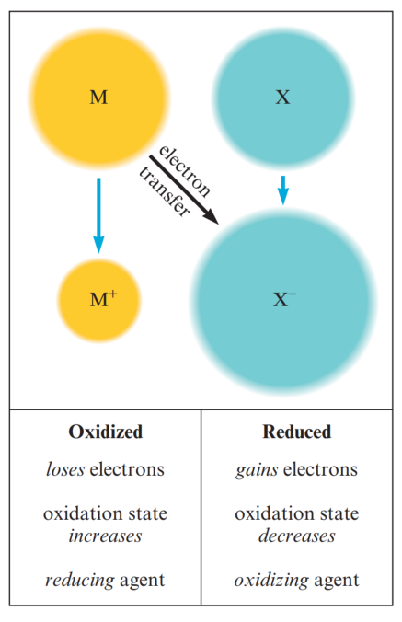

Slide 8
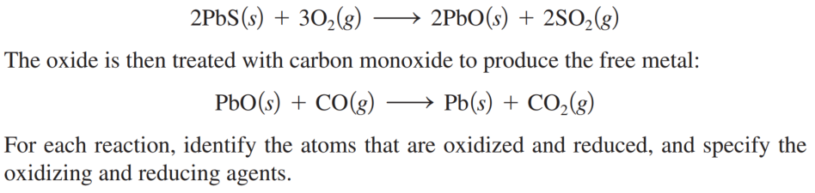
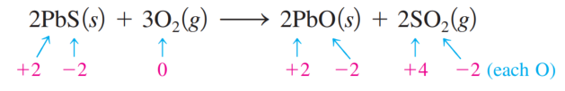

Oxidation–Reduction Reactions: Metallurgy, the process of producing a metal from its ore, always involves oxidation–reduction reactions. In the metallurgy of galena (PbS), the principal lead-containing ore, the first step is the conversion of lead sulfide to its oxide.

Slide 9
Balancing Redox Reaction by Ion electron Method (Half reaction method)
Steps:
Divide the complete reaction into two half-reactions, one representing oxidation and the other representing reduction.
First balance other than ‘O’ and ‘H’ atoms.
In acidic or neutral medium balance oxygen atoms by adding H₂O molecule and balance H-atoms by adding H⁺ ions.
In an alkaline medium, the oxygen atom is balanced by adding H₂O molecule and an equal number of OH⁻ ions are added on the opposite side. H⁺ atoms still unbalanced add OH–
Balance the charges by the addition of electrons.
Multiply with a suitable integer such that the number of electrons gets cancelled.
Add both the half-reactions, similar terms are subtracted and the final equation is written.

Slide 11

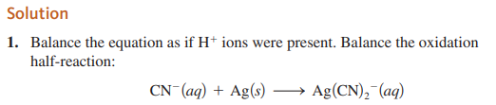
Balancing Oxidation–Reduction Reactions (Basic): Silver is sometimes found in nature as large nuggets; more often it is found mixed with other metals and their ores. An aqueous solution containing cyanide ion is often used to extract the silver using the following reaction that occurs in basic solution:

Slide 12
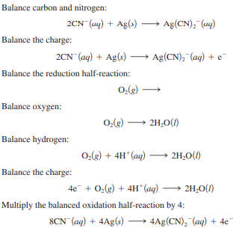

Slide 13
